Slide 1
BCP Investments
Lucas Bledsoe, Patrick Carlin, and Tim Prier

Slide 2
Presentation Outline
Introductions
Overview and Objectives of Our Strategy
Explanation of Fundamentals and Factors
Backtest Analysis
Weaknesses of Strategy and Improvements
Future Outlook of Our Strategy

Slide 3
Momentum Strategies Overview
Overview
Strategies in practice
Jegadeesh and Titman (1993, 2001) - Found evidence that stocks that perform well over 3-12 month span continue this trend over the next 3-12 months
Strategy has continued to branch out to several sub-sectors like cross sectional, time series, dual momentum, etc.
Objectives/Limitations
Want to ride momentum, win big.
Large Drawdowns
Volatility

Slide 4
Investment Thesis
Thesis: Through analysis of several growth fundamentals combined with a cross sectional momentum strategy, we will look to capitalize on incremental gains in the market in order to maximize our portfolio.
Primary Fundamentals
Returns over past 30 days
PE Ratio
Price momentum
Additional Factors
High liquidity of stocks
Quality of momentum
Beta-hedging
Primary Objectives
Maximizing returns, Alpha, and Sharpe ratio
Minimizing expected drawdowns and volatility
Optimizing beta-hedging in order to maintain a slightly higher Beta

Slide 5
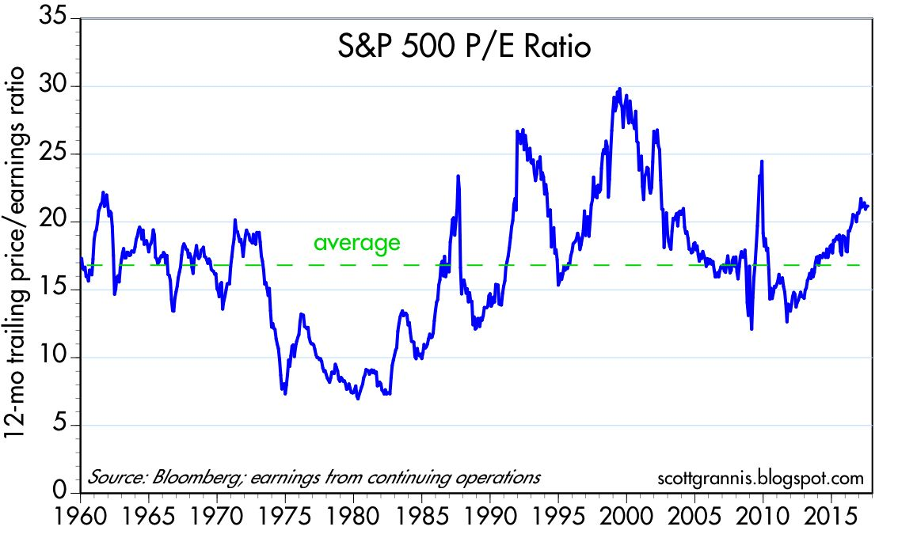
Fundamental Analysis: PE Ratio
Higher PE ratios indicate an expectation of growth from investors
Our strategy looks to utilize this expected growth in riding an upwards trend
Standardization effects
PE Ratio provides a standardization over the market and creates better opportunity for comparison of stocks
Stability over time
Average PE has remained stable over time while being subject to upwards trends

Slide 6
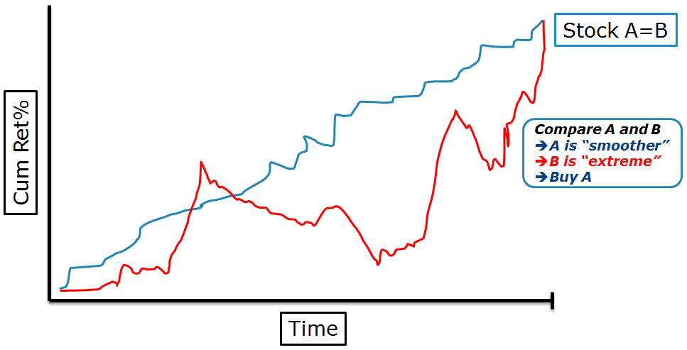
Fundamental Analysis: Quality of Momentum
Smoother returns signals more stable returns and larger momentum tendencies (Gray, 2014)
“Frog in the Pan” analogy
“Limited Attention”
Looking for continuous stream of attention from investors rather than large news events

Slide 7





Price Momentum Indicators
Cr. GastaltU & Meb Faber
**Goal: Measure Trend Strength

Slide 8
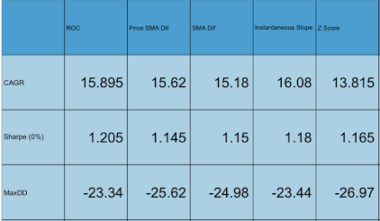
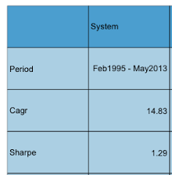

Performance of Indicators: 1995-2013
Cr. GastaltU
Individual Indicator Performance
Aggregate System Performance
*MaxDD : -22.41 Volatility: 11.21

Slide 9
Our Strategy
Pipeline consists of three indicators:
Returns over the past 30 days
PE ratio
Price momentum
Long criteria: Stocks that fall in the top 5% of each indicator
Short Criteria: Stocks that fall in the bottom 5% of each indicator
Rebalance weekly
Long leverage to short leverage is 3:1 - looking to capitalize more on longs
Once stocks fall outside this criteria, we sell

Slide 10
Risk Management: Beta Hedging
Wanted to rely less on beta and more on our strategy.
Beta’s between portfolio and SPY using returns from the past year.
Average beta’s between portfolio assets and SPY.
Hedge against the market. (SPY)
Short depending on beta exposure.

Slide 11
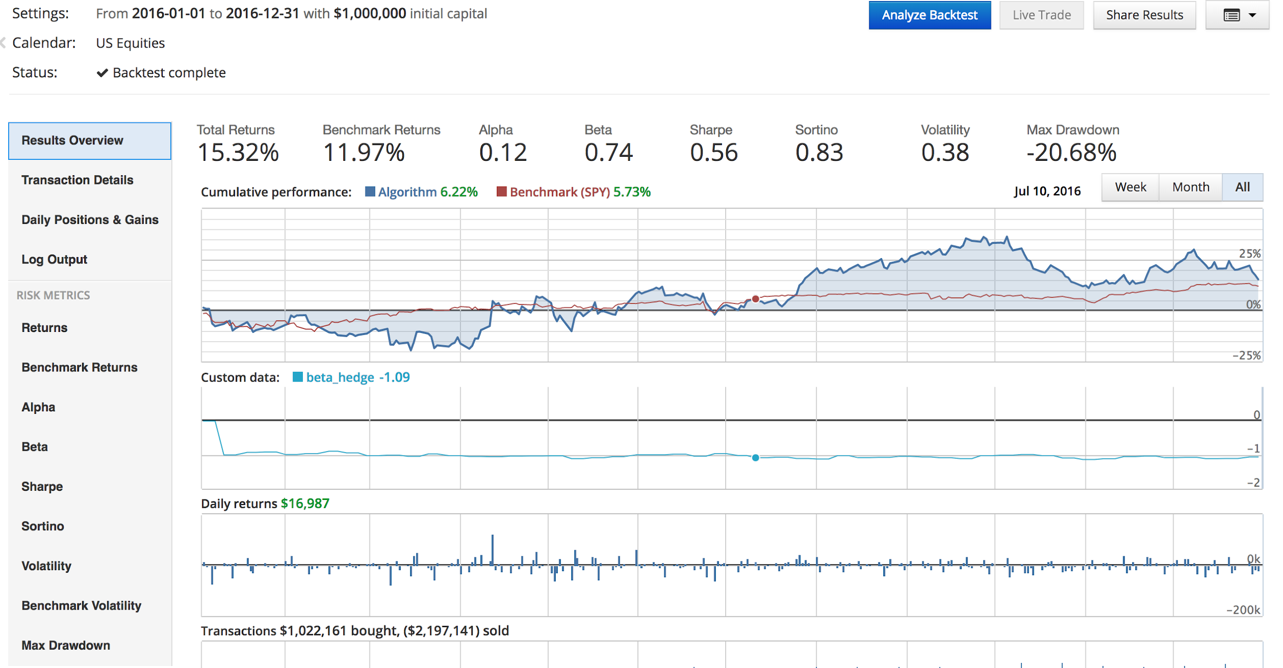
Backtest: Jan 1 2016 - Dec 31 2016

Slide 12
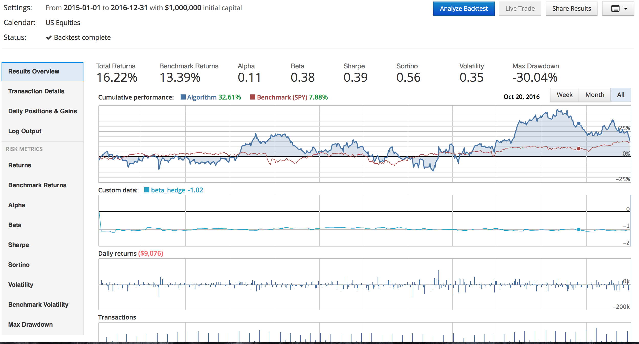
Backtest: Jan 2015 - Dec 2016

Slide 13
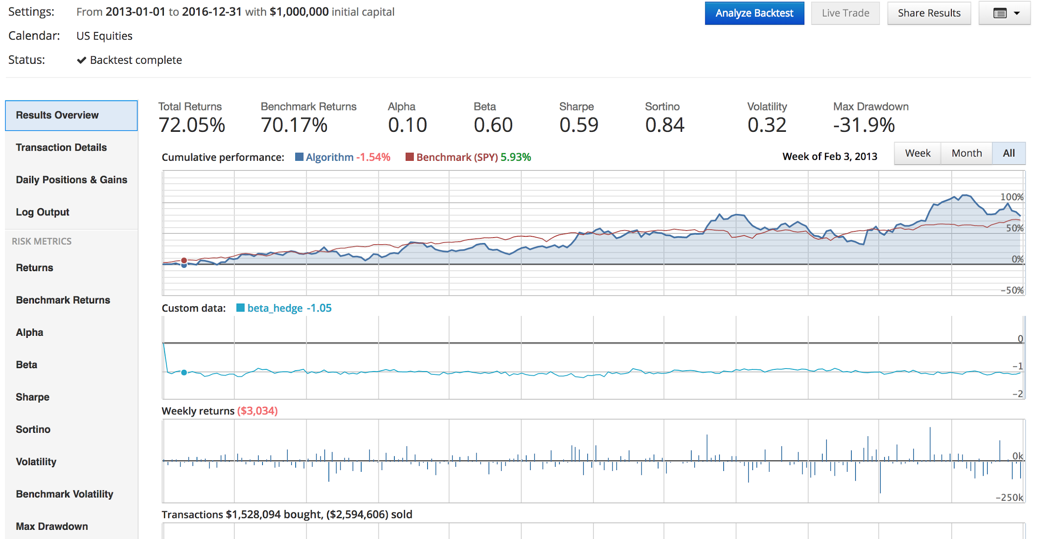
Backtest: Jan 2013 - Dec 2016

Slide 14
Weaknesses
General
Lower Sharpe Ratio (Riskier)
Fewer trading signals (hard to predict the peak)
Market sensitive - financial crises hit hard
Maintenance of diffusion of information
Algorithm Specific
High P/E is not always indicative of future performance
P/E is most meaningful when analyzed within sectors

Slide 15
Improvements
Further optimization of beta-hedging in order to minimize drawdowns and volatility
Finding optimal look back period
Implementing seasonality trends
Difference in high momentum portfolios and low momentum portfolios is largest at the end of each quarter (Sias (2007)) due to “window dressing” and tax incentives at the end of December
Exploring other momentum indicators
Earnings momentum, dual momentum (relative vs. absolute momentum)
Combination of other strategies
Ex. Combine with mean reversion - inherent risk adjustment factor

Slide 16
Outlook of Future Momentum Trading
Inherent volatility and drawdowns make it difficult for most investors to rely on momentum trends
Strategy is certainly geared towards larger investment firms rather than individual traders
Momentum requires constant maintenance of financial news and rapid reactions to market trends
Resources are not as vast for individual investors
Applications to other exchanges
Has shown success in FX markets
Possible pivots into cryptocurrency markets (Bitcoin, Ethereum, etc.)

Slide 17
Thanks for listening. Questions?

